Slide 1
CS 4662 Heart Failure Prediction Presentation
Team Members: Harish Lakshman, Steven Gonzales, Shalini Nistala
Date April 26th 2025

Slide 2
Introduction
Purpose:
"To create and compare different machine learning algorithms for generating predictive models aimed at predicting Heart Failure based on patient data."
Goals:
"Utilize the dataset containing patient characteristics diagnosed with cancer to train and test various models and algorithms. The ultimate goal is early and accurate cancer diagnosis through machine learning."

Slide 3
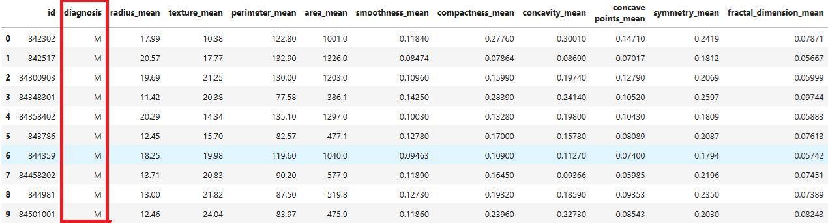
Methodology
Data Overview:
“Cancer dataset includes features such as radius mean, texture mean, etc., depicted in Figure 1."
Data Processing Steps:
"Datasets were loaded into data frames from sklearn."
"Features and labels were analyzed through histograms and box plots to understand distributions and outliers (Figures 1 and 2)."
"Statistical summaries provided insights into feature behaviors (Figure 2)."
"Categorical data within the features was identified and transformed for model training."
Figures 1

Slide 4
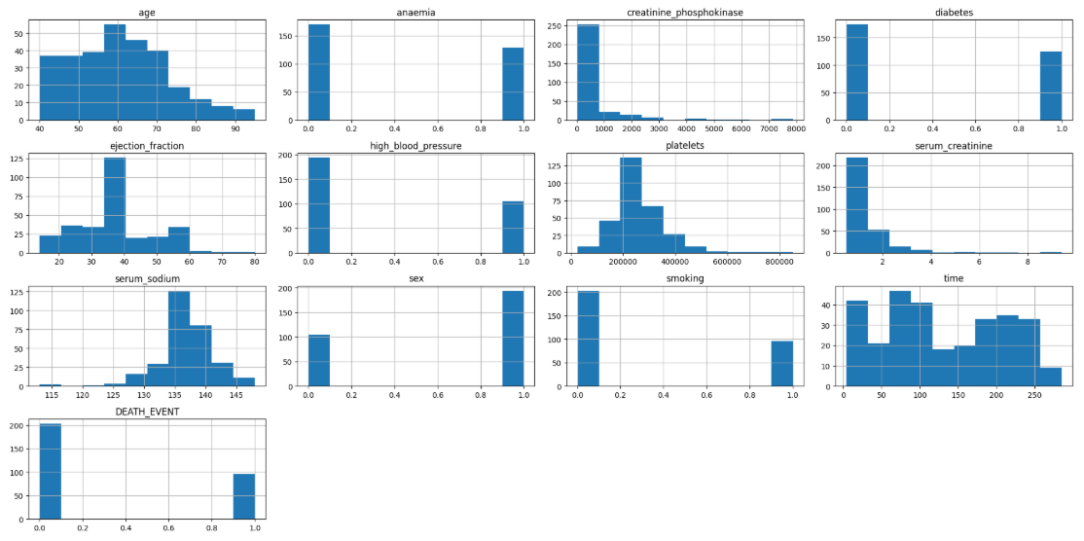
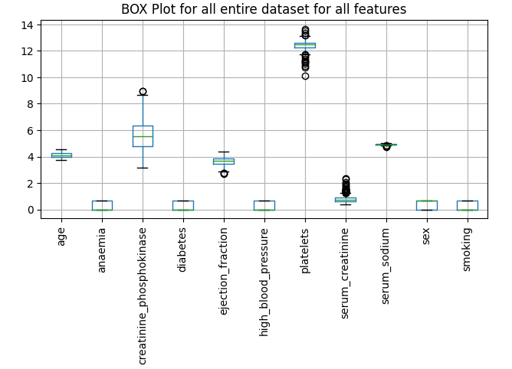
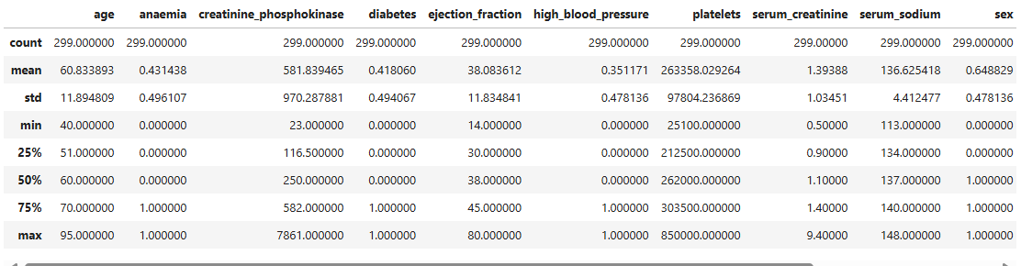
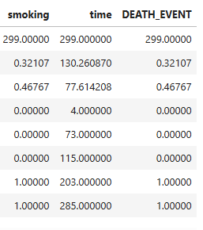
Figures 1: Histograms show distribution of numerical data for features
Figures 3: Box plot shows a graphical representation of the mean, median, standard deviation & outliers for all features
Figures 2: statistical summary tabulates the box plot results in an easy-to-read description
Data Analysis & Feature Extraction

Slide 5
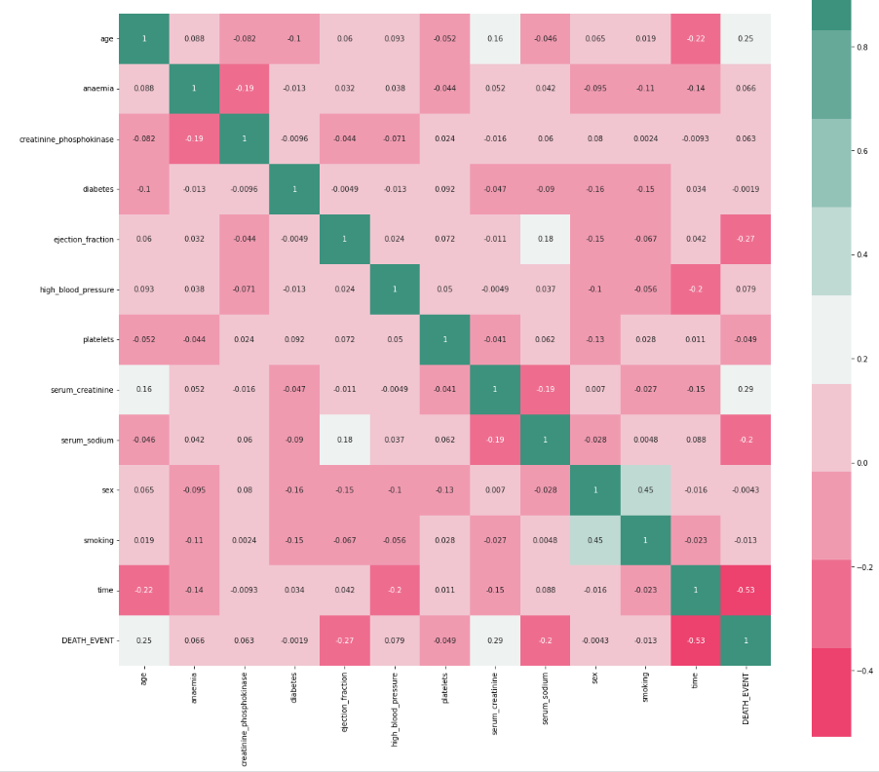
Feature Co-relations (no major co-relations found

Slide 6
Machine Learning Algorithms used
Convolutional Neural Network
Implement Conv1D to extract meaningful local patterns from features of Heart Failure Dataset
Used MaxPooling to reduce dimensionality (pool_size=2)
GlobalAveragePooling flattens into a vector
Added Dense layers for final prediction
Artificial Neural Network (SkLearn method & Keras/TensorFlow methods)
Implement ANN by instantiating as an "object" of MLPClassifier "class"
Attempted cross-validation, Grid search with single hidden layer & Grid search with 2 layers.
Implemented a Sequential model from Keras module with 4 Dense layers.
Support Vector Machines
Implement Support Vector classifier for classification task on Heart Failure Dataset.

Slide 7
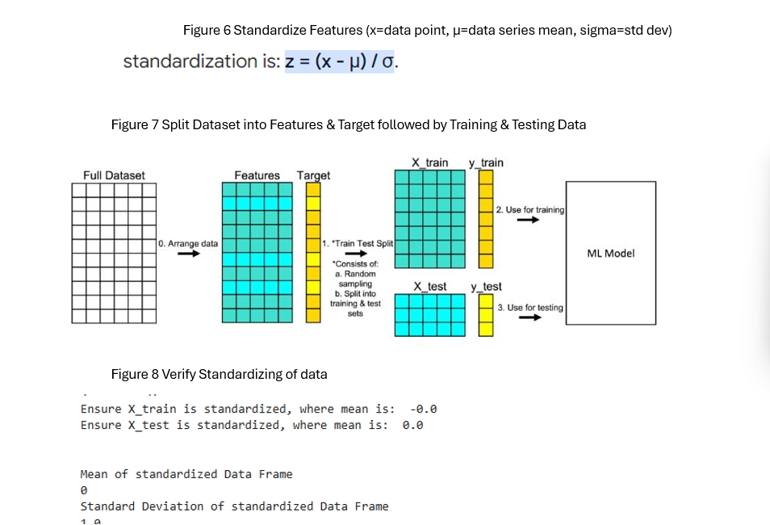
Extract Features & Labels. Standardize Features. Encode Labels & Split data

Slide 8
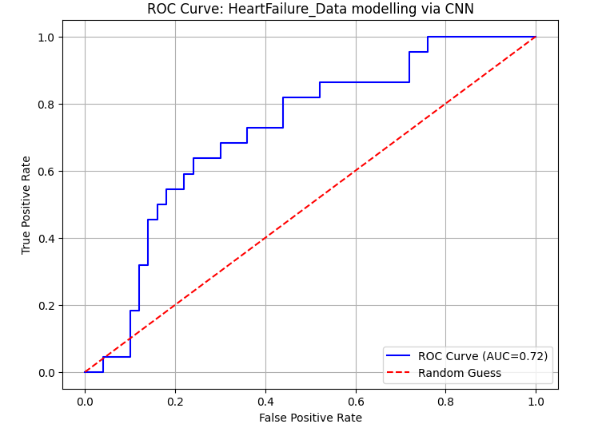
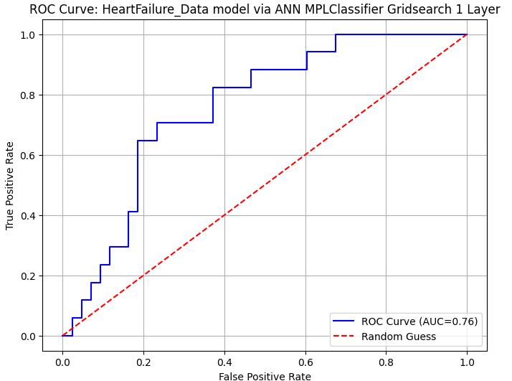
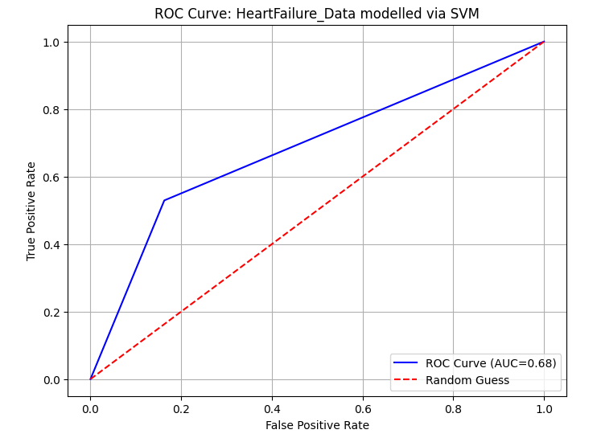
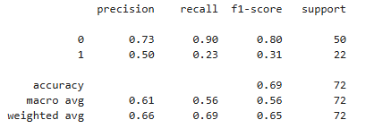
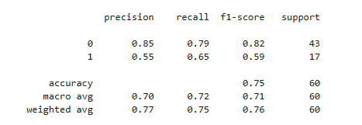
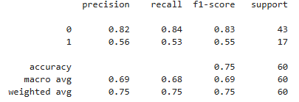
Compare ROC, Accuracy & AUC

Slide 9
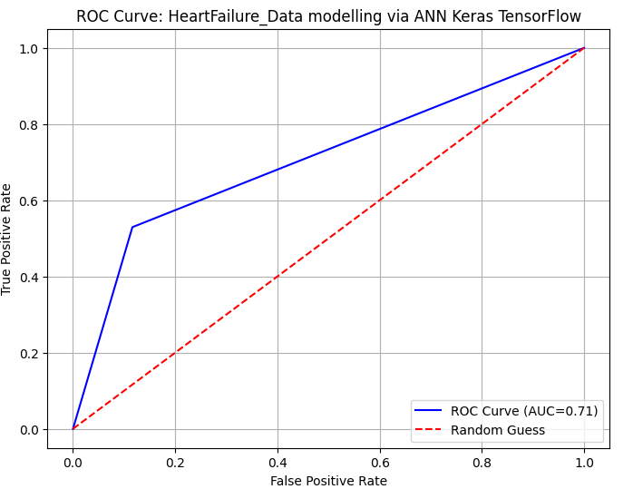
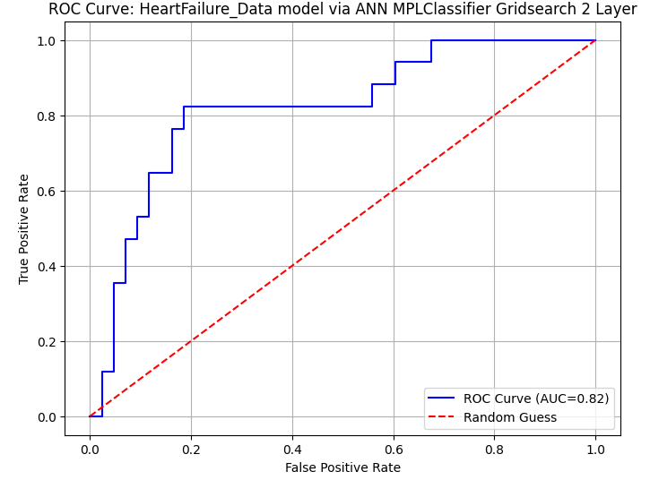
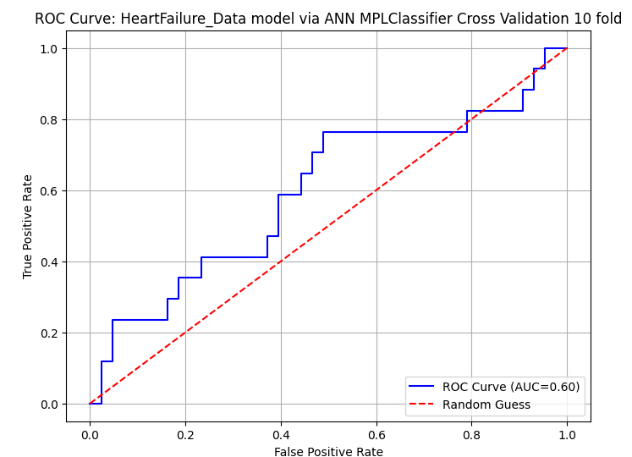
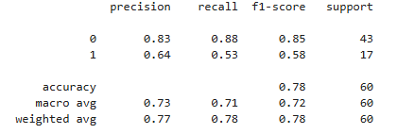
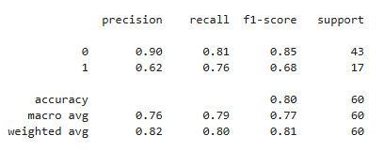
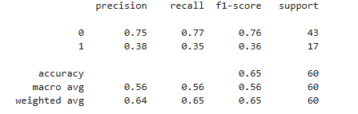
Compare ROC, Accuracy & AUC

Slide 10
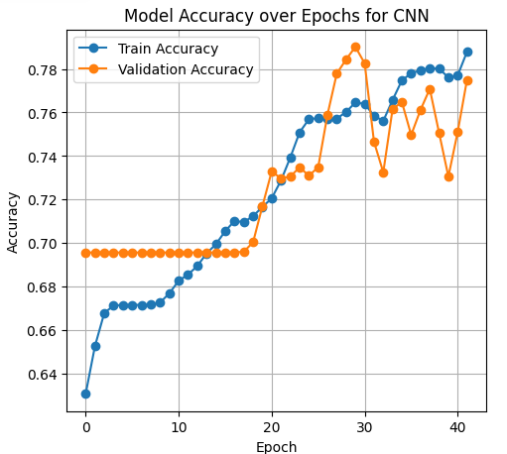
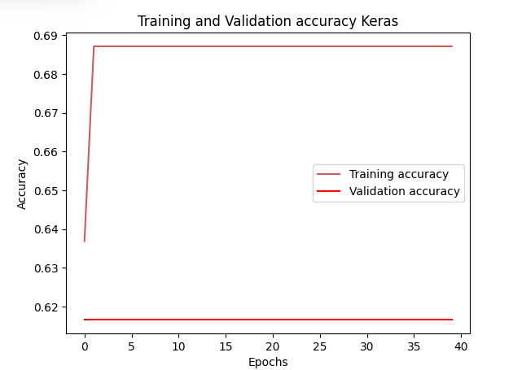
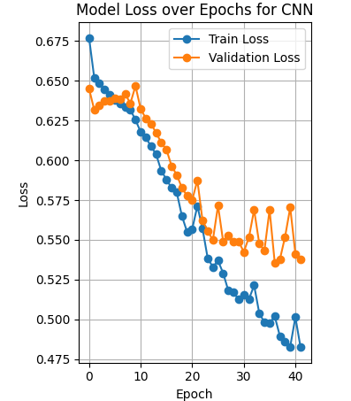
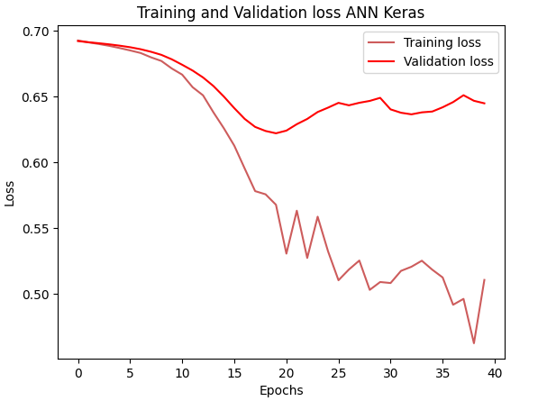
Compare Accuracy over Epochs for 1D CNN & ANN Keras

Slide 11
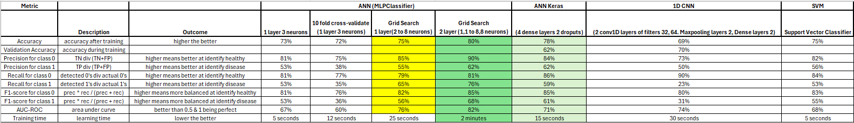
Metrics for all my executed Models

Slide 12
Code
Our code

